Slide 1
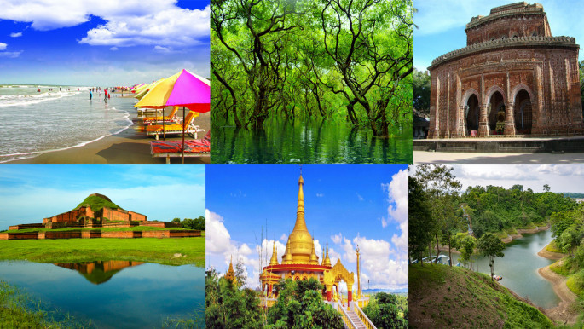
TOUR PLANNING: A TIME-CONSCIOUS END TO END TOURIST PLACES RECOMMENDATION SYSTEM
Supervised By
Dr. Md Mostofa Kamal Rasel

Slide 2

Group Members
1. Fima Faria Lisa
2020-1-60-026
2. Noshin Tasnim Khan
2020-1-60-221
3. Farhana Jaman
2020-1-60-006
4. Ayesha Chowdhury
2020-1-60-003

Slide 3



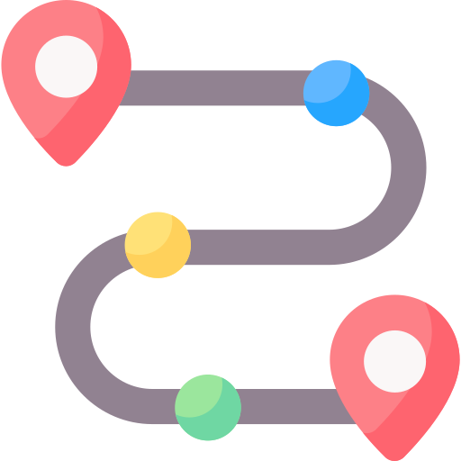
Introduction
Definition A tourist recommendation system helps plan tours by providing personalized recommendations.
How Does a Tourism Recommendation System Work? Uses data like preferences, history, and context to suggest destinations and accommodations aligned with user interests.
Existing Recommendation Systems Existing systems consider traveller’s likes, history, location, distance and cost, to recommend multiple places.
What else can be offered? Suggests optimal routes based on user preferences, time, and location.

Slide 4
Literature review
Traveler’s Recommendation System Using Data Mining Techniques:
The system recommends nearby attractions based on user interests, location, and popularity using KNN and Apriori algorithms.
Measuring Tourist Experience in
Semarang City through an Advanced Recommendation System
The system uses content-based and collaborative filtering to recommend popular and highly rated destinations based on user preferences and ratings.
Tour Spot Recommendation System via Content-Based Filtering
The system recommends picnic spots based on user interests, budget, past visits, and factors like location, safety, transport, and climate.
A Tourism Route-Planning Approach Based on Comprehensive Attractiveness:
The system rates routes based on distance, travel time, cost, and popularity, using algorithms like simulated annealing and genetic algorithms, with real-world data from Beijing sites.

Slide 5
Issues in the existing system
One research uses Euclidean distance, which may not accurately reflect real-world distances.
Recommend only one place to visit from their list of suggested spots.
01
04
None of them considers recommending the tour plans based on the endpoint
None of them considers recommending the tour plans based on the endpoint.
Most of the system does not account for travel time constraints.
02
05
One research was conducted on a small dataset. However, if dataset becomes larger, then time complexity increases exponentially that affects the real time recommendation.
Limited data availability in one of this systems may affect recommendation accuracy and also Recommendations may be biassed based on the dataset used.
03
06

Slide 6

Motivation
Traditional travel recommendation systems often overlook how many places travelers can visit within their time constraints. Therefore, we need
a recommendation system that suggests the best sequential route within these constraints.
Recommending the most suitable places considering endpoint destination to ensure a fulfilling travel experience within the available time.
Providing travel routes and sequences for visiting multiple places within the given time constraints.
Suggesting an optimal sequence of places to visit based on the user's starting point, ending point, and available time.

Slide 7
Objectives
Gather data on tourist spots.
Representing tourist spots possible routes between them are represented as edges and nodes.
Evaluate distances between spots.
Represent the weight of nodes and edges.
Find as efficient cost function to evaluate the scores for the candidate considering the weight of nodes and edges.

Slide 8

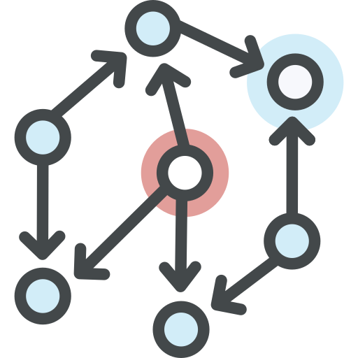


Problem Statement
Collecting Tourist Spots Dataset
How to collect the dataset of tourist spots in Bangladesh.
How to process and store the dataset for proper use.
Graph Construction
How to construct routes between tourist spots.
How to evaluate distances between one spot to another.
How to represent weight of nodes and edges.
Recommendation
How to select the candidate spots considering the start- and end- points.
How to measure the weighted cost of a route.
User Interaction
How to make a user-friendly and effective website and mobile application.

Slide 9
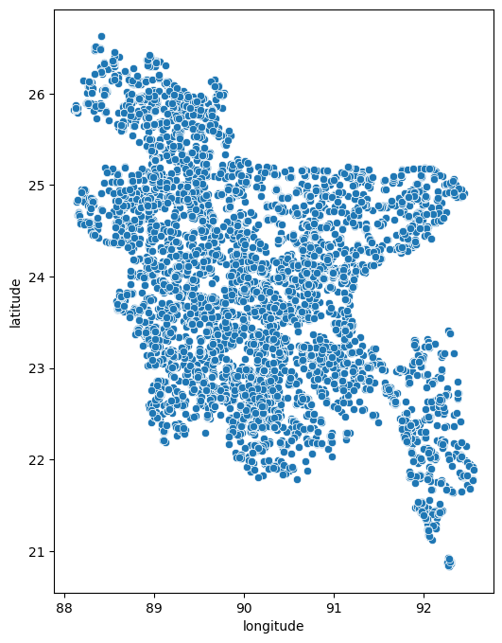
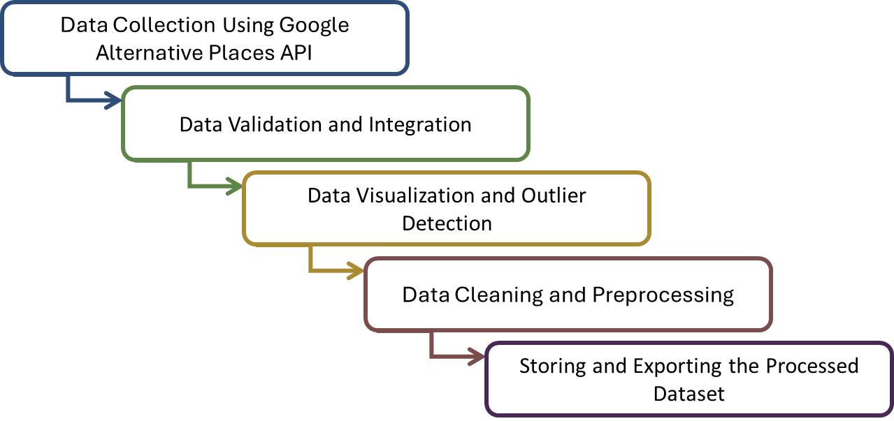
Data Collection Methodology

Slide 10
Proposed Work
Graph Construction Phases:
Database
Data Preprocessing
Graph Construction
Fetch Reference Point
Filter Unique IDs
Find Nearest Neighbours
Fetch End Point
Calculate Distances
Add Connections
Fetch Places in Batches
Filter Places
Graph

Slide 11


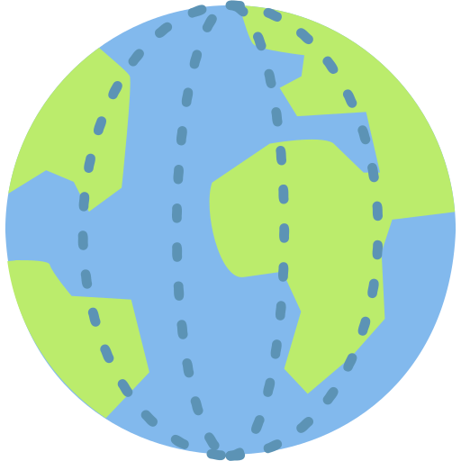



Tourist Places Data
Title | Latitude | Longitude | Category | Rating | Rating Count
Jaflong Zero Point | 25.1822945 | 92.0178976 | Tourist attraction | 4.4 | 2702
Humayun Rashid Chattar | 24.8776 | 91.8755 | Historical landmark | 5 | 1
Tilagarh Eco Park | 24.9174221 | 91.906369 | Tourist attraction | 4.1 | 1834
Ali Amjad's Clock | 24.8883669 | 91.8677713 | Historical landmark | 4.5 | 4130
Ratargul Swamp Forest | 25.0141875 | 91.9187031 | National forest | 4.5 | 6287
Panthumai waterfall | 25.1779997 | 91.9555912 | Tourist attraction | 4.4 | 902
Hazrat Shahjalal Rah. Mazar Sharif | 24.9022558 | 91.8666685 | Tourist attraction | 4.4 | 4800

Slide 12
Graph Representation
6.29km, 0.13hr
Jaflong Zero Point
Panthumai Waterfall
18.59km, 0.37hr
21.19km, 0.42hr
Ratargul Swap Forest
15.80km, 0.32hr
14.90km, 0.30hr
13.51km, 0.27hr
1.43km, 0.03hr
Humayun Rasid Chattar
Ali Amjid’s Clock
10.83km, 0.27hr
1.55km, 0.03hr
5.41km, 0.11hr
5.06km, 0.10hr
2.88km, 0.06hr
Tilagarh Eco Park
Hazrat Shahjalal Rah. Mazar Sharif
4.34km, 0.09hr

Slide 13
Proposed Work
Recommendation Phases:
Path Finding
Optimization
Output
Fetch Rating & Counts
Select Path
Graph
Calculate Path Distance
Prepare Results
Find All Paths
Apply Knapsack Algorithm
Display Result

Slide 14
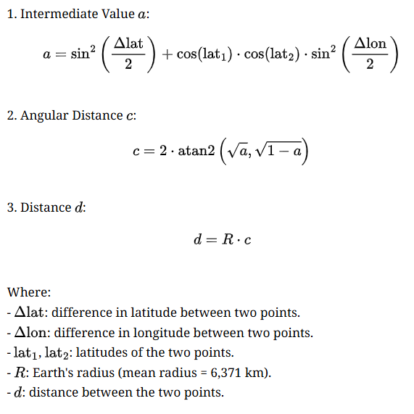
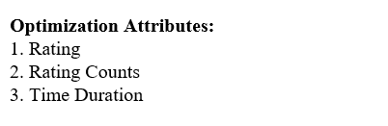
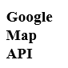
Optimization Attributes and Mathematical Models
Knapsack with dynamic optimization
Haversine Formula
DP[i][t] = max(DP[i−1][t], DP[i−1][t−Segment Time] +Segment Profit)
Where:
i: Index of the route segment.
t: Available time.
Segment Time: the time required to travel the current segment.Segment Profit: Score based on ratings, count, and time duration.

Slide 15
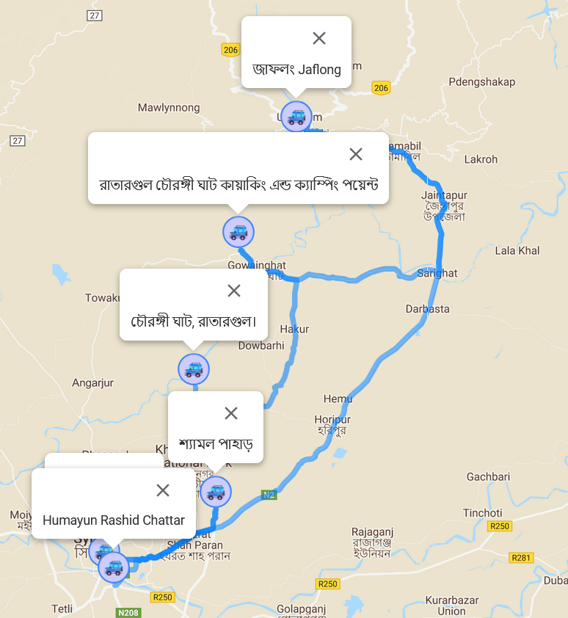
Experimental Result
Input:
Travel Time: 4 hours
Current Location: Humayun Rashid Chattar
End Location: জাফলং Jaflong
Algorithm | Route | Score | Travel Time
Knapsack with dynamic optimization Runtime: 1.45 seconds seconds | Humayun Rashid Chattar -> চৌধুরী ঘাট, রাতারগুল -> Ali Amjads Clock -> জাফলং Jaflong | 4170.86 | 3.35 hours
 | Humayun Rashid Chattar -> রাজরাজেশ্বর চৌধুরী ঘাট -> Ali Amjads Clock -> জাফলং Jaflong | 4157.46 | 3.78 hours
 | Humayun Rashid Chattar -> ম্যাসাল পাহাড় -> Ali Amjads Clock -> জাফলং Jaflong | 4133.44 | 3.10 hours

Slide 16
Experimental Result
Algorithm | Route | Score | Travel Time
Knapsack dynamic with Traffic optimization Runtime: 21.12 seconds | Humayun Rashid Chattar -> Ali Amjads Clock -> Jaflong Zero Point -> জাফলং Jaflong | 6844.59 | 3.10 hours
 | Humayun Rashid Chattar -> Ali Amjads Clock -> Shahi Eidgah দক্ষিন চত্বর -> জাফলং Jaflong | 6363.74 | 3.10 hours
 | Humayun Rashid Chattar -> Ali Amjads Clock -> Tilagarh Eco Park -> জাফলং Jaflong, | 5976.23 | 3.37 hours
Simulated Annealing Runtime: 25.97 seconds | Humayun Rashid Chattar -> চৌধুরী ঘাট, রাতারগুল ->Ali Amjads Clock ->জাফলং Jaflong | 4170.86 | 3.35 hours
 | Humayun Rashid Chattar -> Ali Amjads Clock -> রাহাত মঞ্জিল -> জাফলং Jaflong | 4150.54 | 3.03 hours
 | Humayun Rashid Chattar -> Ali Amjads Clock -> গাজিউর হাওর -> জাফলং Jaflong | 4146.72 | 3.11 hours
Multiple criteria decision making Runtime: 21.84 seconds | Humayun Rashid Chattar -> চৌধুরী ঘাট, রাতারগুল -> Ali Amjads Clock -> জাফলং Jaflong | 4167.68 | 3.35 hours
 | Humayun Rashid Chattar -> Ali Amjads Clock -> রাহাত মঞ্জিল-> জাফলং Jaflong | 4147.75 | 3.03 hours
 | Humayun Rashid Chattar -> Ali Amjads Clock -> গাজিউর হাওর-> জাফলং Jaflong | 4143.84 | 3.11 hours

Slide 17

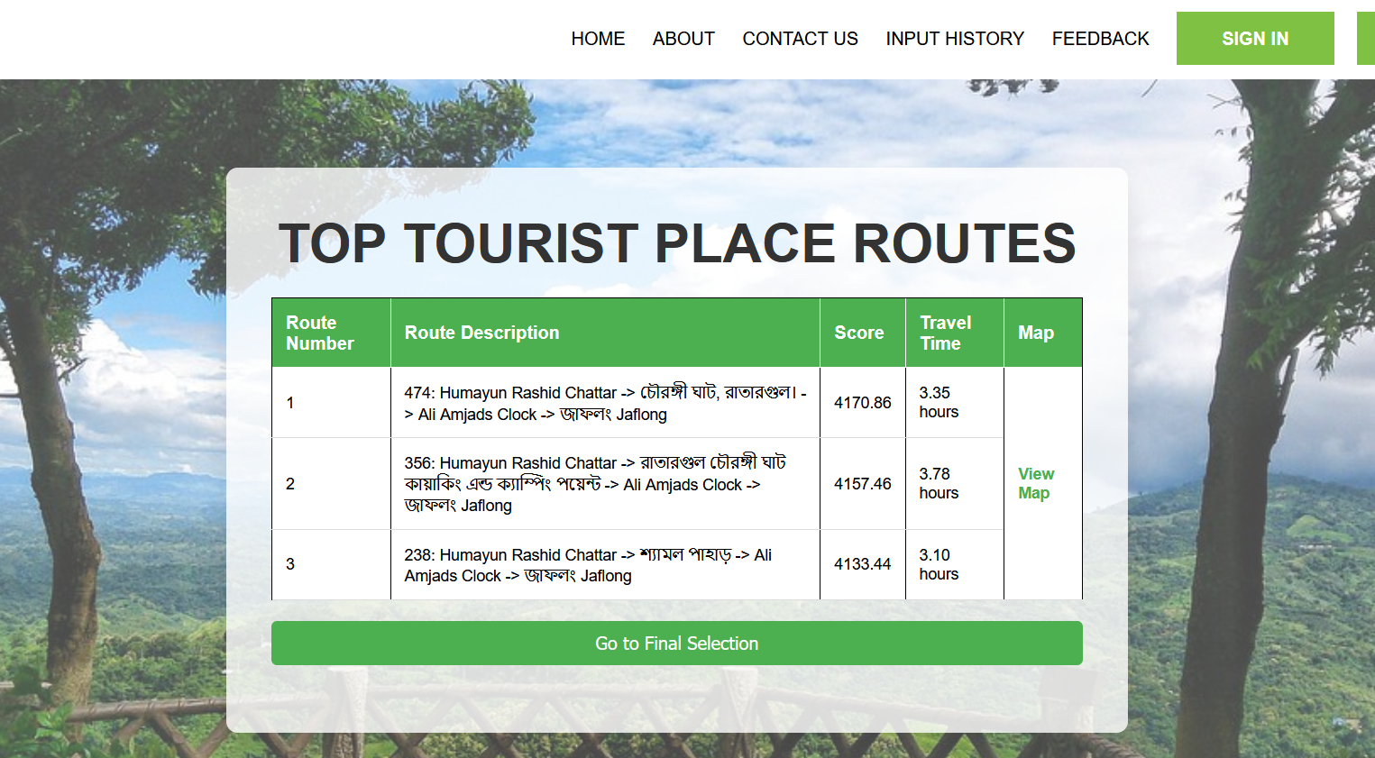
User Interface

Slide 18
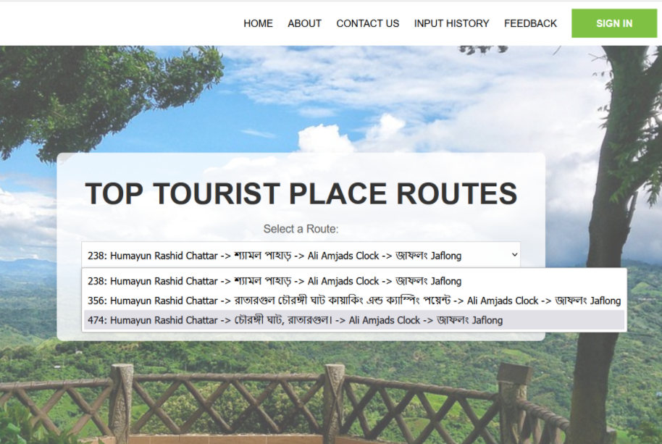
Route in Map
Selecting Route

Slide 19
Conclusion
Developed an end-to-end recommendation system considering start and end points for seamless travel planning.
Introduced time-conscious optimization using the Knapsack Algorithm for efficient route planning.
Leveraged advanced geospatial and data processing techniques for accurate, high-quality recommendations.
Designed a user-friendly interface to enhance the travel planning experience.

Slide 20
QUESTIONS

Slide 21
THANK YOU !

